Slide 1
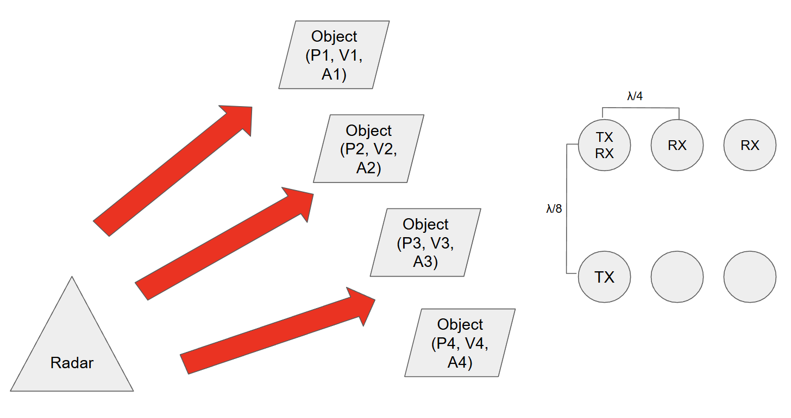
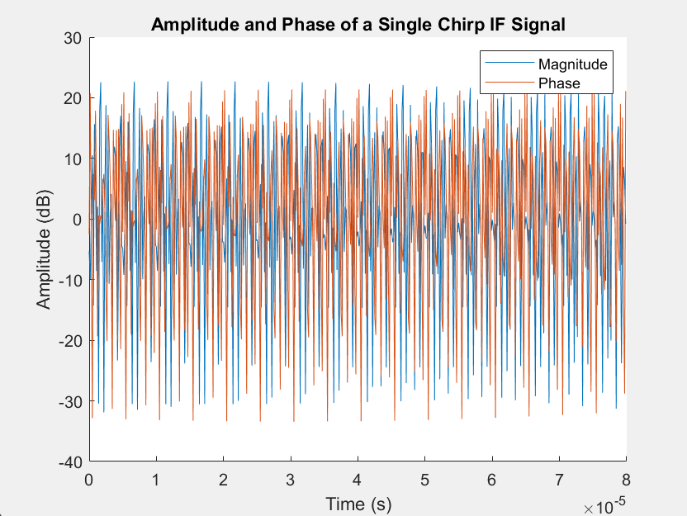
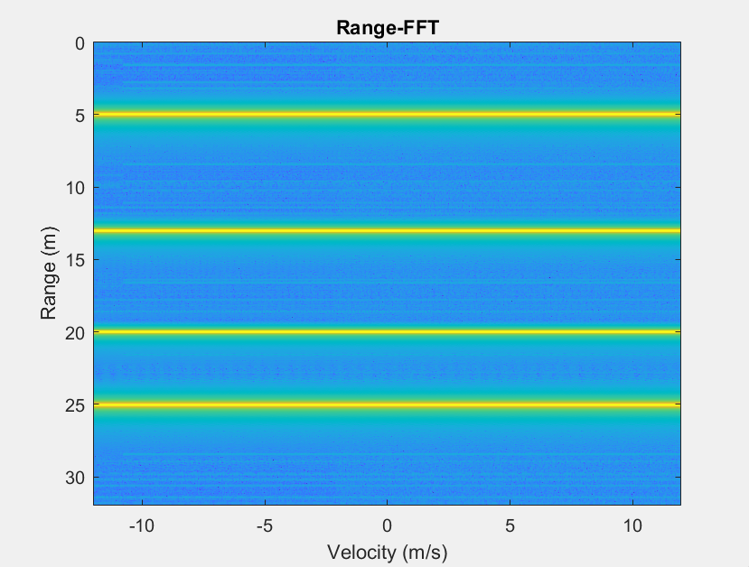
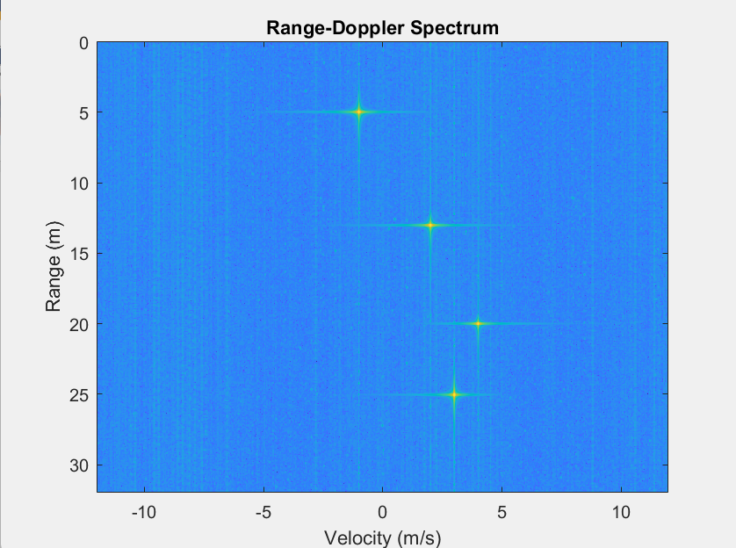
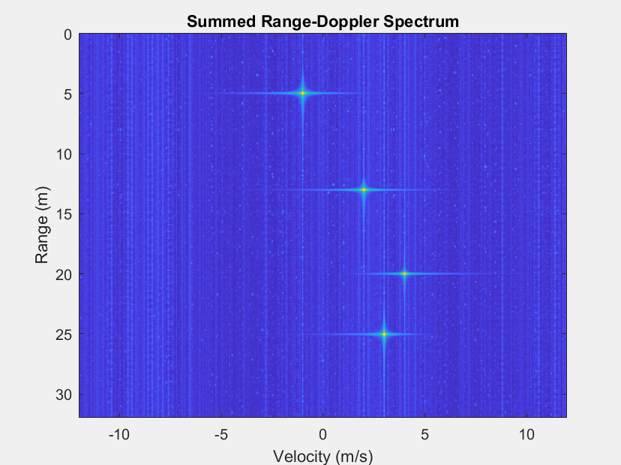
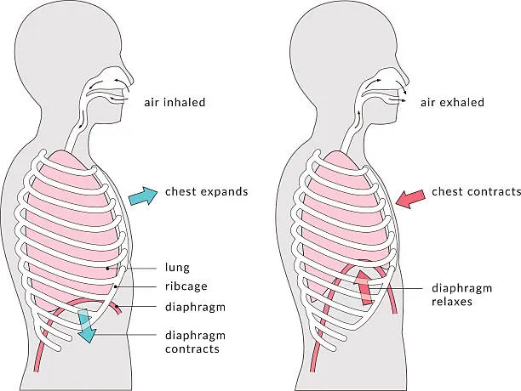
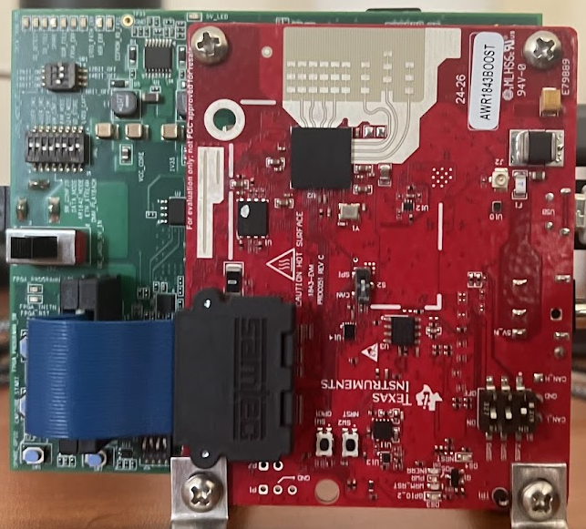
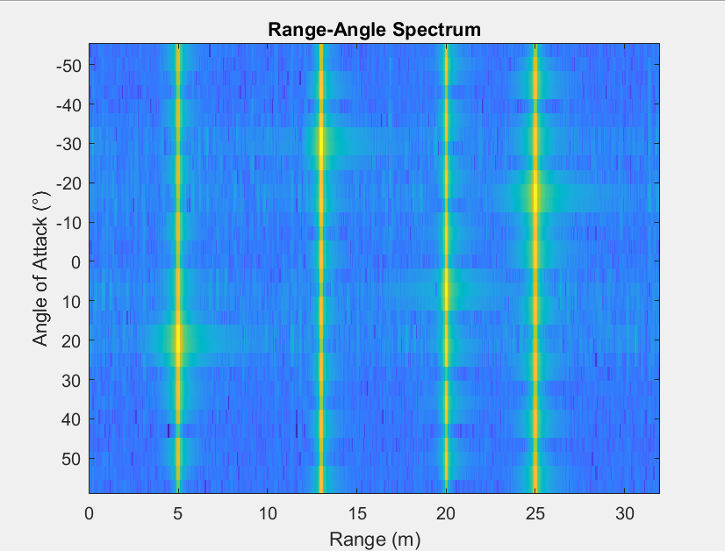
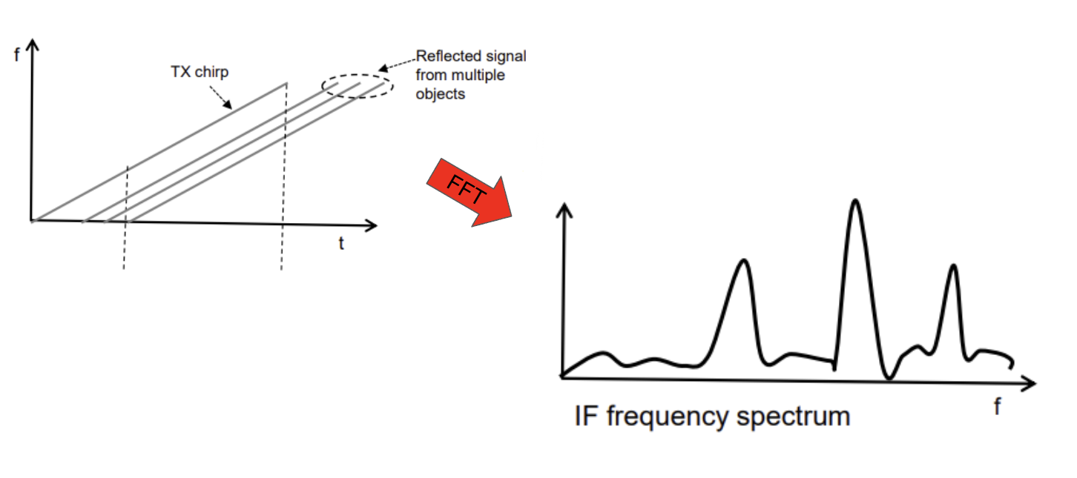
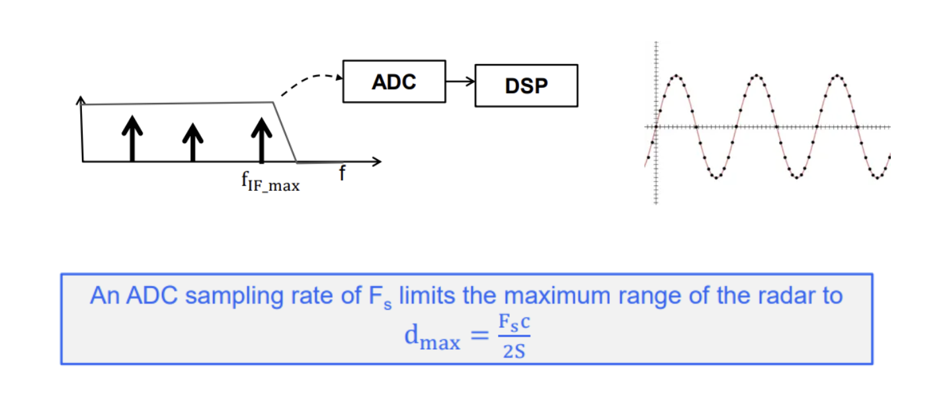
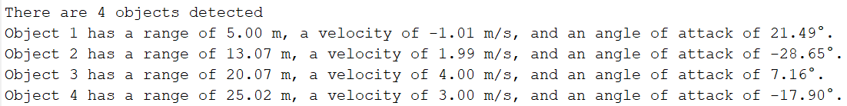
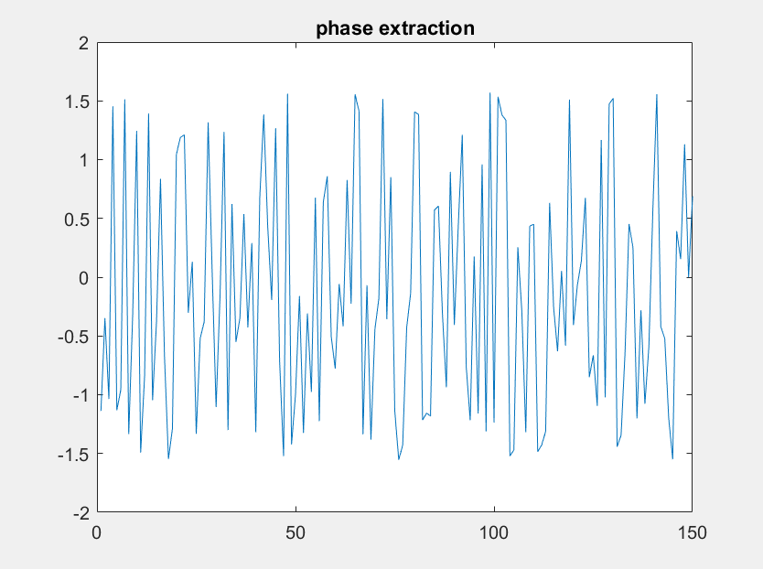
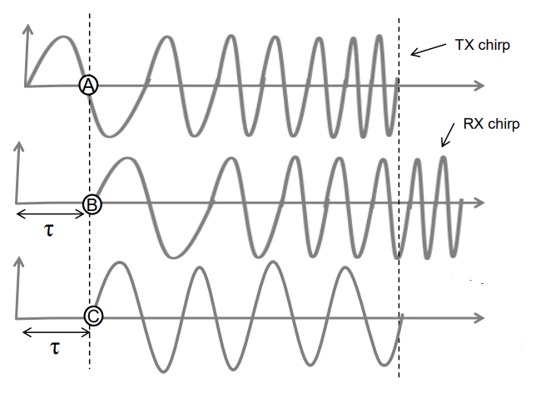
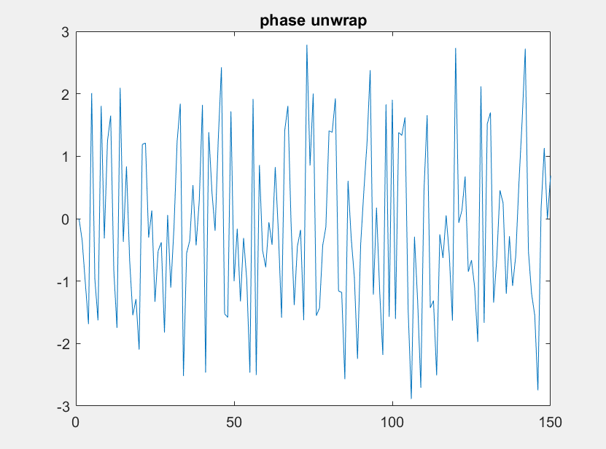
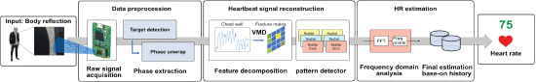
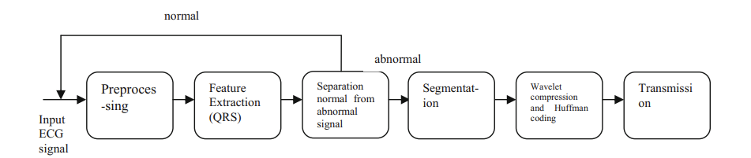
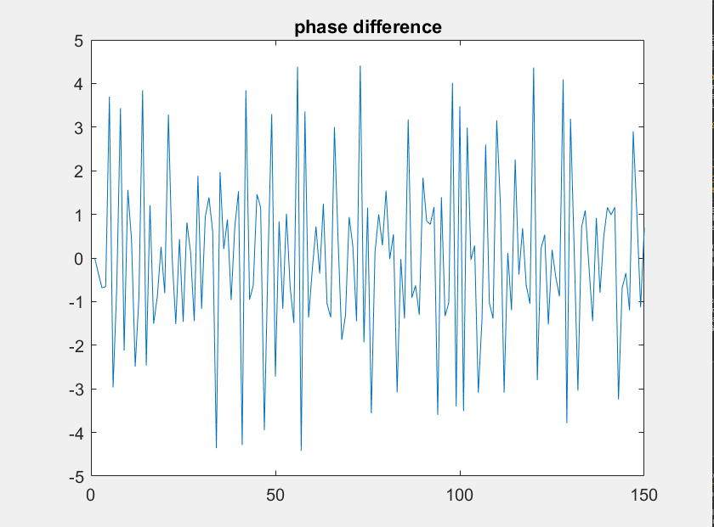
Development of a Closed Loop FMCW Radar Device to Extract Biometric Data for Security and Irregularity Detection
Areesh Sobhani [Purdue University]
Mentor: Dr. Qiuye He [University of Missouri Kansas City]
MATERIALS AND METHODS
RESULTS
Introduction
Current limitations of commercial ECG and respiratory detection technology
Current limitations of wireless heart rate sensing research
Limitations of different domain transforms
Abstract
WILL WRITE WHEN PROJECT SCOPE IS CAPPED
Probably a good idea to split this into two sections???
ADD PICTURE OF EXPERIMENTAL SETUP !!!!!!!! (next time it’s set up)
* WILL ADD WHEN DATA COLLECTION IS FINISHED :((((
RELATED WORK / BACKGROUND
- List of all references exists, wait to add until project scope is capped
Dr. Lee
Dr. He
NSF
UMKC

